Slide 1
An application of Basic Formal Ontology to the Ontology of Services and Commodities
Barry Smith and Wolfgang Grassl
http://ifomis.org/bfo/

Slide 2
Basic Dichotomy between Commodities and Services
Commodities are things (created things, including software, which survive their act of creation, can be stored, rented, …)
Services are processes (production and consumption always coincide)
Utilities involve both a commodity side (you rent e.g. the phone network) and a service side (you use the phone network when you make a call)

Slide 3
Basic Formal Ontology
rests on a top-level distinction among all entities between (roughly) things and processes
things are material entities, they continue to exist through time
processes are not made of material parts; they occur through time, cycling through a succession of phases

Slide 4
For BFO
both commodities and services are entities with economic value
commodities are things (CONTINUANTS)
services are processes (they are processes in which production and consumption coincide) (OCCURRENTS)

Slide 5
Music
Consumer’s perspective
Producer’s perspective
Taxation authority’s perspective
What is a music CD, which (in olden times) people used to buy in stores?

Slide 6
Is it a commodity? (because it is a physical object)
Or is it a service? (because it is a musical performance?)

Slide 7
A similar problem with outsourcing
Many manufacturing companies used to do everything in-house.
Now many outsource as much as possible: janitors, accounting, data processing, sales, human resources, etc.
Before these jobs were counted as manufacturing because they were employees of manufacturing companies. Now, since the same jobs are part of an out-sourcing firm, they are considered service jobs

Slide 8
Traditional Opposition between Embodied and Splintered Services
Embodied | Disembodied/Splintered
haircutting | LPs, CDs
consulting | books, newspapers
nursing | painting
prostitution | advertising
teaching | television, telephone <?>
transport | software on the net <?>

Slide 9
Definition
Service = an economic good for which production and consumption coincide

Slide 10
‘splintered’ (‘disembodied’) services
are classified as services even though their production and consumption do not coincide
Hence the confusions we saw above

Slide 11
in BFO terms
Commodities are CONTINUANTS
Services are OCCURRENTS

Slide 12
Is a CD a commodity or a service?
Standard view: when I buy a CD I am buying services of a composer and performers. (OCCURRENT)
Correct view: I am buying a commodity, which is ontologically no different from a car or a bag of rice. (CONTINUANT)

Slide 13
Two Kinds of Commodities
consumable (bananas)
non-consumable (roads, telephone lines)
The latter afford services OCCURRENT
as an ocean affords swimming
On affordances see http://ontology.buffalo.edu/eco/Ecological_Psychology.pdf

Slide 14
Strict, independent services | Dependent Services | Selling manu-factured goods | Renting manufactured goods
haircutting | advertising | LPs, CDs | car rental
consulting | selling, transport | books, newspapers | telecommunications
nursing | input service (typing) | painting | road networks
prostitution |  | advertising
teaching
television, theatre performances | television, theatre technical services |  | software on the net <?>
another part of the standard view that is wrong

Slide 15
Are telecommunications commodities?
Do we rent the telephone system for 5 seconds?
Do we rent services (like buying a hairdresser’s services for 5 minutes)?
Are telecommunications like water or electricity? = Commodities which come down pipes

Slide 16
Television and telecommunications
are similar ontologically: each has two components: the network and the utilization of the network
= continuants plus occurrents

Slide 17
From the consumer’s perspective however
Television is a service industry:
We watch television in order to enjoy the services of the actors.
The network and delivery mechanism are secondary.
Not so for telephone ‘service’: telecommunications is an industry analogous to car rental.
We want to use the actual physical mechanical network object.

Slide 18
Car rental is like home rental
it is the purchase of an object for a certain time.

Slide 19
Phone sex,
like other stuff which comes down the phone line, is a service.
But the telecommunication system itself is a commodity, which we rent in just the same way that we rent a free-standing public telephone in an airport.
You still pay for your telephone connection when no one is using the line.

Slide 20
Is software a service
When you buy a piece of shrink-wrapped software you sign a license agreement. Is this renting software?
Are things any different if you download the software from the internet?
If it becomes unusable after 30 days?

Slide 21
Dependent services
What of:
    Transport services
    Insurance services
    Protection services (army services)
    Buying and selling services
    ?

Slide 22
For services
production and consumption coincide both spatially and temporally
Therefore
–services are characterized by the fact that renting is impossible.
Services can only be purchased.

Slide 23
See
Wolfgang Grassl,
“The Reality of Brands: Towards an Ontology of Marketing”
American Journal of Economics and Sociology, 58, 1999, 313-359
http://papers.ssrn.com/sol3/Delivery.cfm/SSRN_ID1646137_code116609.pdf?abstractid=1646137&mirid=1

Slide 24
An adequate ontology of the marketing phenomenon:
must include three categories:
  Substances (things, commodities, manufactured goods)
  Processes (also called events: services)
  Settings (environments, niches, contexts, situations)
  See: http://ontology.buffalo.edu/smith/articles/napflion.pdf

Slide 25
Barry Smith,
Objects and Their Environments: From Aristotle to Ecological Psychology
in A. Frank, J. Raper and J.-P. Cheylan (eds.), The Life and Motion of Socio-Economic Units, London: Taylor and Francis, 2001, 9–97.
http://ontology.buffalo.edu/smith/articles/napflion.html

Slide 26
The value of a commodity
is dependent upon the setting in which it exists at the moment of purchase.
The value of a service is dependent upon the setting in which it exists at the moment of delivery.

Slide 27
Telephones
are physical goods. They have traditionally been regarded as services because they afford usage (they have the dispositional property of providing services).
The traditional categorization is erroneous, because this dispositional property applies no less to cars, pianos, rice.

Slide 28
Settings
the ensemble of environmental features within which a purchase is made (environmental features which are relevant to the purchase).
CONSIDER: BUYING A CAR

Slide 29
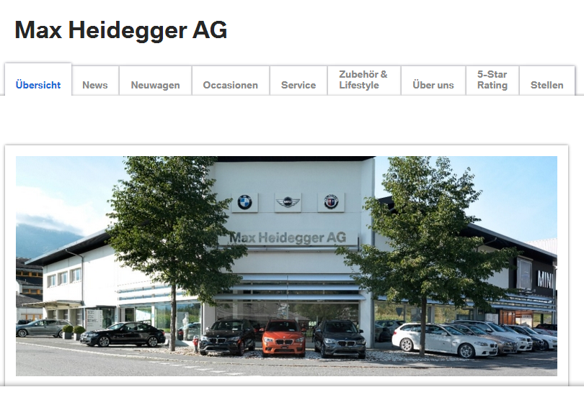

http://www.heidegger.li/

Slide 30
A CD is a commodity
because one can either buy it or rent it.

Slide 31
An Ontology of Prostitution and Slavery
A1 x is a commodity → x is necessarily of such a sort that it can either be bought or rented.
A2 x is a service → x is necessarily of such a sort that it can only be bought.
A3 x is a person → x is necessarily of such a sort that it can neither be bought nor rented
A4 people cannot own other people

Slide 32
Can you rent potatoes?
Renting has to do with control, with power over that which is rented
Ownership can survive without control.

Slide 33
Definition of renting
x rents y to z : x owns y and x allows z to use y for limited time in exchange for recompense proportionate to the length of time involved.
(There is an assumption that y will be available for multiple time periods.)
Theorem: There is nothing which can only be rented.
Proof: From the definition of renting, and the assumption that people cannot own other people.

Slide 34
Services can never be assets
Assets can always be depreciated.
People cannot be depreciated. People cannot be assets
Know-how is an asset. You can buy know-how (like brand equity)
Know-how (like human capital in general) is a CONTINUANT entity
Application of know-how is an OCCURRENT entity (a process)

Slide 35
Definition of buying
What does it mean to buy a commodity?
There is a transfer of property rights. There does not have to be any physical dislocation or removal.
What does it mean to buy a service?

Slide 36
You cannot rent people
What is involved in employing people? Do you buy their labour or do you rent their labour.
Marx: the commonsensical view according to which we can rent or hire bodyguards is mistaken. We do not rent bodyguards; we buy the services of bodyguards for given time periods. (See also escort agencies.)
Why is this ontologically different from renting?
Because when you rent something, this thing exists for a period of time beyond the rental time, and can in principle be rented again. Services, however, are time-perishable.

Slide 37
Counter-argument
Surely you can rent a bodyguard, because the bodyguard exists for a longer period of time than the time in which you rent him.
No: you buy the services of the person

Slide 38
More on the ontology of services
A service is the actualization of a disposition. Therefore you cannot render the same service twice.
(Type-token distinction. Every haircut is unique.)

Slide 39
Acts vs. Products
The service is the act, not the product
The service is the haircutting, it is not the result (a pattern in the hair on your head)

Slide 40
BFO categories we need
CONTINUANT entities
Examples
  Persons
  Material things such as laptops
  Portions of stuff such as water or oil

Slide 41
More BFO CONTINUANT entities
qualities
  examples:
    the pattern of hair on your head that is an outcome of the haircutting process
    the pattern of connectedness of the plumbing system in your house that is an outcome of the plumbing process
dispositions
  example:
    your knowledge of Greek that is the outcome of a teaching process

Slide 42
Settings (more CONTINUANT entities)
of purchase
of delivery (for commodities)
of use (for commodities)
of delivery (for services)
of assessment for tax purposes (of commodities and services ...)

Slide 43
Settings
Axiom: When you buy a service you also buy a delivery setting.
And the delivery setting has the same temporal extent as the service itself. (Hairdressers)
The delivery setting for commodities is transient. They bring you the car and leave.

Slide 44
The Ontology of Real Estate
Can you buy a setting?
When you buy real estate, you buy a house and you also buy its setting. Real estate is like services in that its setting endures for as long as it does.
Adam Smith: real estate is the only economic good that is not perishable.

Slide 45
See
Barry Smith and Leonardo Zaibert,
The Metaphysics of Real Estate,
Topoi, 20: 2 (September 2001), 161–172
http://ontology.buffalo.edu/smith/articles/lz.htm

